Slide 1
Search
The N-Queens Problem
www.cs.colostate.edu/~cs115/Queens.ppt
Most slides from Milos Hauskrecht

Slide 2
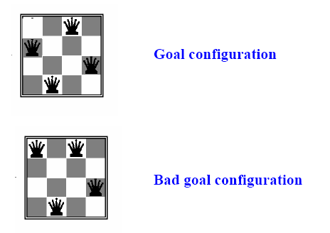
N-queens problem
Find a configuration of n queens not attacking each other

Slide 3
What is the maximum number of queens that can be placed on an n x n chessboard such that no two attack one another?
The answer is n queens, which gives eight queens for the usual 8x8 board

Slide 4
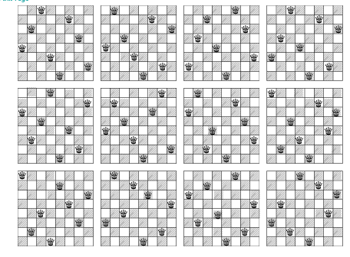
12 Unique Solutions
8-Queens Problem

Slide 5
8-Queens Problem
There are 92 distinct solutions
There are 12 unique solutions discounting symmetrical answers (rotatations/reflections)
How many solutions for 4-Queens? N-Queens?
Wikipedia.org

Slide 6
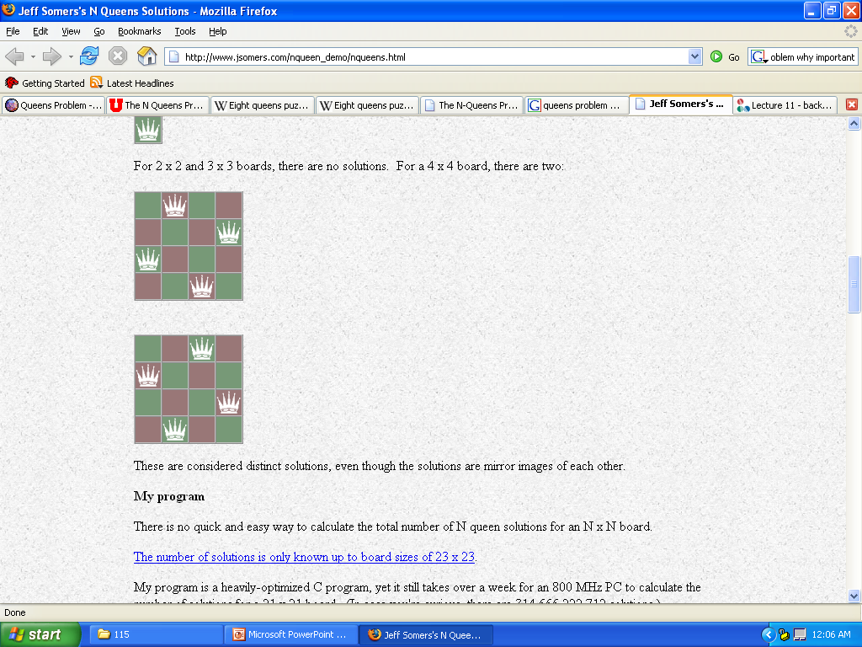
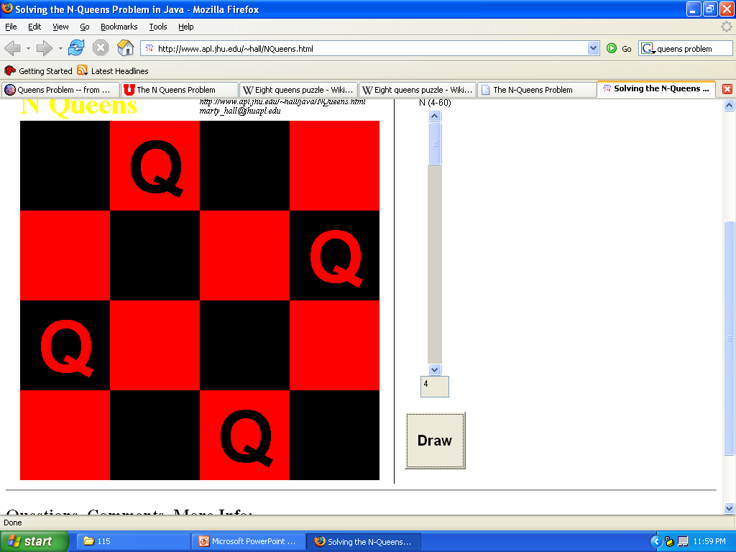
Problems N < 4
N < 4
Cannot use N Queens
3
2
1

Slide 7
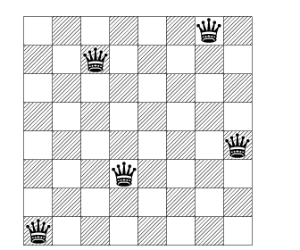
What is the minimum number of queens needed to occupy or attack all squares of an 8x8 board?

Slide 8
Search
Solving problems by searching
  Some problems have a straightforward solution
  Just apply the formula, or follow a standardized procedure
  Example: solution of the quadratic equation
  Hardly a sign of intelligence
More interesting problems require search:
  more than one possible alternative needs to be explored before the problem is solved
  the number of alternatives to search among can be very large, even infinite.

Slide 9
Search Problems
is defined by:
Search space:
– The set of objects among which we search for the solution
Example: objects = routes between cities, or N-queen configurations
Goal condition
– What are the characteristics of the object we want to find in the search space?
– Examples:
    Path between cities A and B
    Path between A and B with the smallest number of links
    Path between A and B with the shortest distance
    Non-attacking n-queen configuration

Slide 10
N-Queens Problem
Problem:
-- How do we represent the search space?

Slide 11
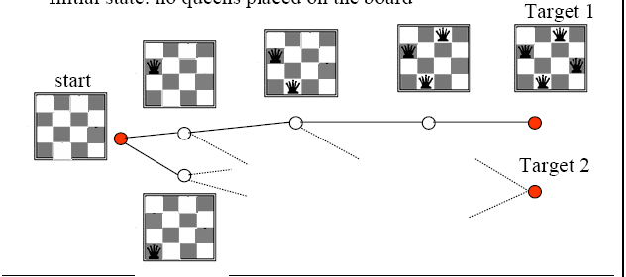
N-Queens as a Graph
Graph search
  A trick: generate a configuration step by step (one queen per step)
  States (nodes) correspond to configurations of 0,1,2,3,4 queens
  Links (operators) correspond to the addition of a queen
  Initial state: no queens placed on the board

Slide 12
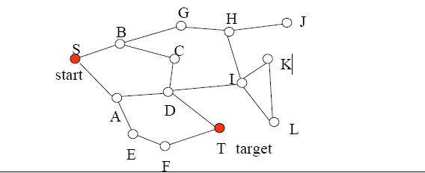
Graph Search
Graph search problem
  States - game positions, or locations in the map that are
  represented by nodes in the graph
  Operators - connections between cities, valid moves
  Initial state – start position, start city
  Goal state – target position (positions), target city (cities)

Slide 13
N-Queens Problem
Problem:
-- How do we represent the search space?
N-Queens
– We look for a target configuration, not a sequence of moves
– No distinguished initial state, no operators (moves)
-- Don’t use a graph

Slide 14
Configuration search (constraint satisfaction search)
  – Find a state (configuration) satisfying the goal condition
  – Additional goal criterion: “soft” preferences for
configurations, e.g. minimum cost design

Slide 15
A Solution: Know your domain
Since there are N rows and N queens, there must be a queen in each column (why?),
Put a queen in each row, but also need to pick a row for each queen.
Randomize the rows at the beginning, and then, in each iteration move one queen that reduces the number of threatened queens by a maximum.
We do it in each iteration, until the number if threatened queens reach 0, or we get to a situation where we can’t improve any more, because we had a bad start - so we start over, randomizing locations again, and doing the whole thing again, until the queens a safe spot.

Slide 16
Solution: Backtracking
place a queen in the top row, then note the column and diagonals it occupies.
then place a queen in the next row down, taking care not to place it in the same column or diagonal. Keep track of the occupied columns and diagonals and move on to the next row.
If no position is open in the next row, we back track to the previous row and move the queen over to the next available spot in its row and the process starts over again.
Demo:
http://www.math.utah.edu/~alfeld/queens/queens.html

Slide 17
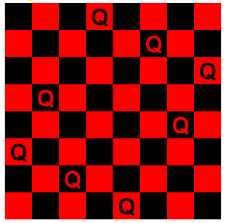
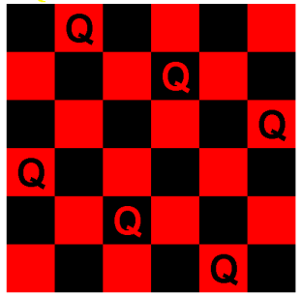
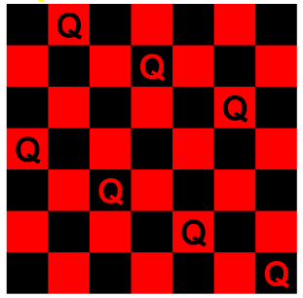
Find 1 Solution: Iterative (non-search)
For N > 4 only
N is even except N ≠ 6K+2 :
  Row 1 to N/2:
  Queen on 2*Row
  Row N/2+1 to N:
  Queen on 2*Row-N-1
N is even, N = 6K+2
  Row 1 to N/2:
  Queen on (2*Row + N/2 - 3)mod N +1
  Row N/2+1 to N:
  Queen on N - (2*(N-Row+1) + N/2 - 3)mod N
N is odd:
  When N is even, no queen is placed on position (1,1).
  So this just places the first N-1 queens as on an N-1 (even) sized board, then places the last queen on the bottom right position (N,N).
8
6
7

Slide 18
Solution: Genetic Algorithms
Maintain a list of potential solutions
Modify potential solutions in parallel
Crossover
  Randomly swap X number of Queen positions
Mutation
  Randomly change a Queen’s position to a new random location

Slide 19
Problems

Slide 20
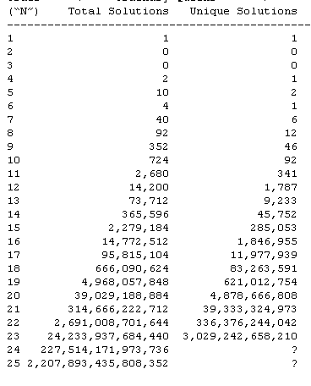
Time is an issue
difficult for a search algorithm such as depth-first search with backtracking to find a solution for the N-queens problem in an acceptable amount of time.
It took over 11 days to get the results for
N = 20

Slide 21
Computational Considerations
Computer solutions to the N-Queens problem are basically the same as the method you would use by hand.
It is simply a brute force trial and error method.
The amount of time required to find all solutions for any order “N” is roughly proportional to “N” Factorial.
It took over 11 days to get the results for “N” = 20.
If we increase “N” to 21, it would take about 4 months for the program to run.
For higher orders of “N”, the problem has to be broken into parts with each part delegated to a separate computer. Thus, dozens and more likely, hundreds of computers are needed to solve problems with “N” in the low 20's. With present computing power, it is unlikely that the total number of solutions will be found when “N” equals 30 or higher.

Slide 22
Why is this important?
In and of itself, the N queens problem is not important.
However, the problem works as an interesting optimization testbed
there are many, many solutions to this problem on the web, but few of them are fast.
Also, techniques used to speed up this code can be used in other areas, such as a chess-playing program or a unit path-finding algorithm for a game.

Slide 23
Search Problems
What do we care about solving such a trivial toy problem?
What other problems require search?
Patents for circuits discovered by a software program!

Slide 24
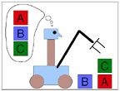
Toy Problems
Ideal for benchmarks, comparisons
  Is your program faster/more efficient than others on problem X?
Solve Sudoku puzzle, size N
Solve crossword puzzles
Traveling Salesman
Ant-colony optimization

Slide 25
Toy Problems in CS
Toy Problems attempts to show examples of interesting systems and questions, which can be addressed well with a little programming, but which are not primarily about programming per se.
Instead, Toy Problems is about the world around us. Examples are taken from basic physics, everyday phenomena, and basic (but interesting) math. What all of them have in common is that they lend themselves to short, easy programs, often with a little graphical output. (If a graph says more than a thousand words, a program producing graphics is a thousand times more interesting to write.)
Another very important point Toy Problems tries to make is that the world around us can be understood.

